Slide 1
LIF 101 lecture 5 or 13 11th March, 2016
DNA as a genetic material and DNA replication

Slide 2
Important early discoveries leading to identification DNA as a genetic material
Fred Griffith (1928) – Experiments with pneumonia and bacterial transformation determined that there is a molecule that controls inheritance.
Oswald T. Avery (1944) - Transformation experiment determined that DNA was the genetic material responsible for Griffith’s results (not RNA).
Hershey-Chase Experiments (1952) – discovered that DNA from viruses can program bacteria to make new viruses.

Slide 3
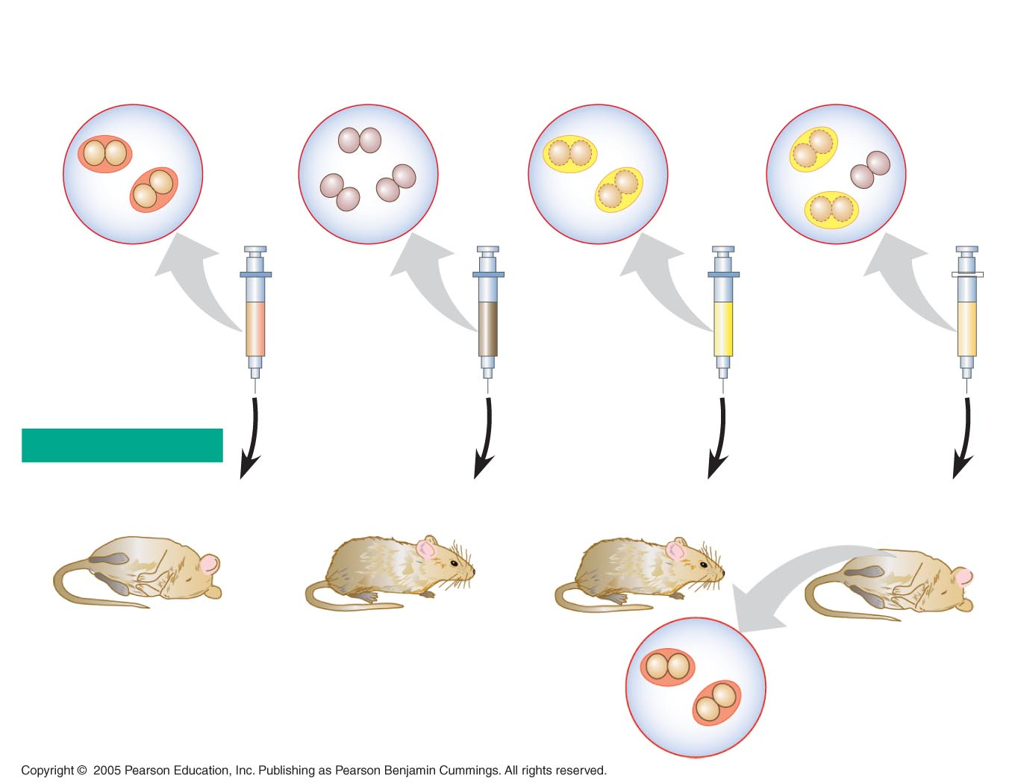
Frederick Griffith’s Transformation Experiment
The discovery of the genetic role of DNA began with research by Frederick Griffith in 1928
Griffith worked with two strains of a bacterium, a pathogenic “S” strain and a harmless “R” strain
When he mixed heat-killed remains of the pathogenic strain with living cells of the harmless strain, some living cells became pathogenic
He called this phenomenon transformation, now defined as a change in genotype and phenotype due to assimilation of foreign DNA
Living S cells
(control)
Living R cells
(control)
Heat-killed
S cells (control)
Mixture of heat-killed
S cells and living R cells
RESULTS
Mouse dies
Mouse healthy
Mouse healthy
Mouse dies
Living S cells
are found in
blood sample

Slide 4
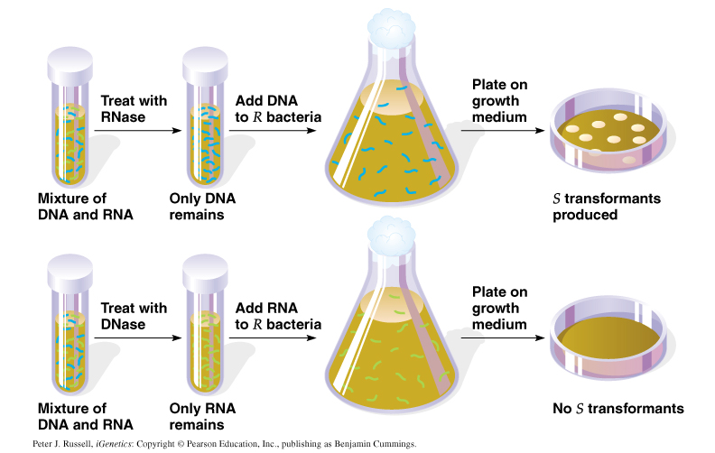
Oswald T. Avery’s Transformation Experiment
In 1944, Oswald Avery, Maclyn McCarty, and Colin MacLeod announced that the transforming substance was DNA
Their conclusion was based on experimental evidence that only DNA worked in transforming harmless bacteria into pathogenic bacteria
Many biologists remained skeptical, mainly because little was known about DNA

Slide 5
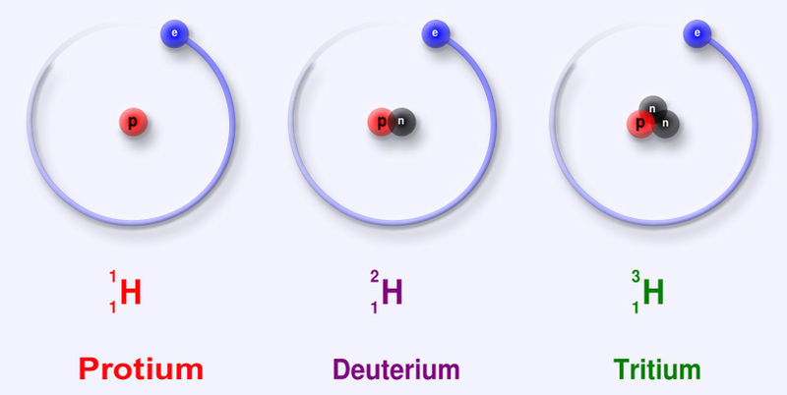
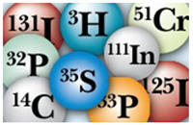
Isotopes of different elements display masses whose nuclei remain are unstable and dissipate energy by spontaneously emitting radiation in the form of alpha, beta and gamma rays
Notes:
Isotope: any of two or more forms of a chemical element, having the same number of protons in the nucleus, or the same atomic number, but having different numbers of neutrons in the nucleus, or different atomic weights. There are 275 isotopes of the 81 stable elements, in addition to over 800 radioactive isotopes, and every element has known isotopic forms. Isotopes of a single element possess almost identical properties.
Radioactive isotope, also called radioisotope, any of several species of the same chemical element with different masses whose nuclei are unstable and dissipate excess energy by spontaneously emitting radiation in the form of alpha, beta, and gamma rays
Phosphorus-32 is a radioactive isotope of phosphorus. The nucleus of phosphorus-32 contains 15 protons and 17 neutrons, one more neutron than the most common isotope of phosphorus, phosphorus-31. Phosphorus-32 only exists in small quantities on Earth as it has a short half-life of 14.29 days and so decays rapidly

Slide 6
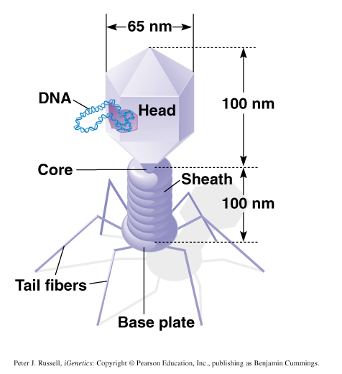
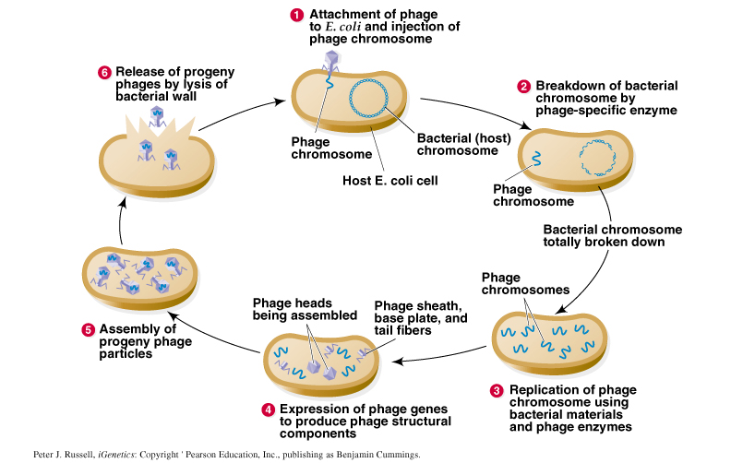
Life Cycle Of Virulent T2 Phage

Slide 7
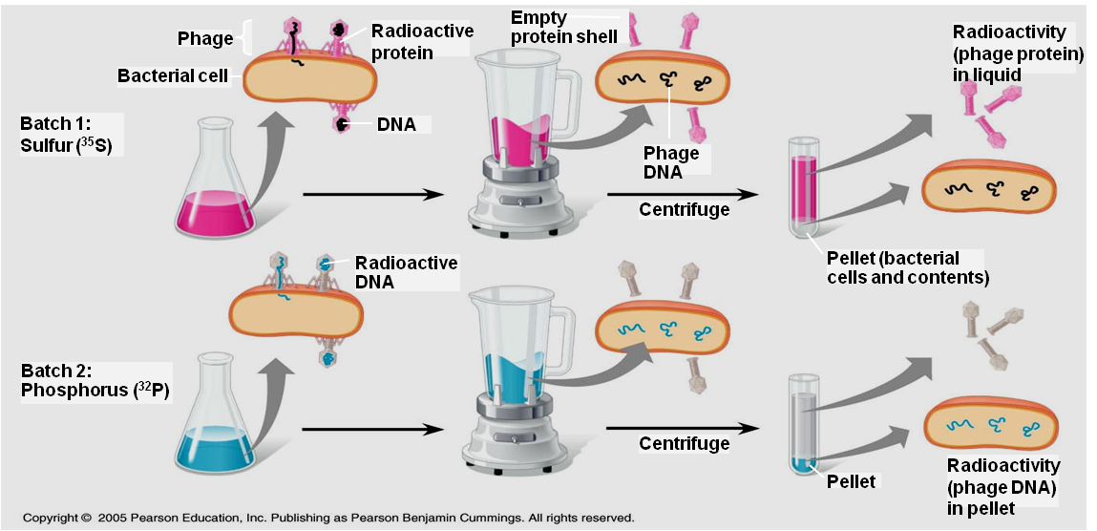
Hershey-Chase Bacteriophage Experiment
In 1952, Alfred Hershey and Martha Chase performed experiments showing that DNA is the genetic material of a phage known as T2
To determine the source of genetic material in the phage, they designed an experiment showing that only one of the two components of T2 (DNA or protein) enters an E. coli cell during infection
³²P is discovered within the bacteria and progeny phages, whereas ³⁵S is not found within the bacteria but released with phage ghosts.
They concluded that the injected DNA of the phage provides the genetic information

Slide 8
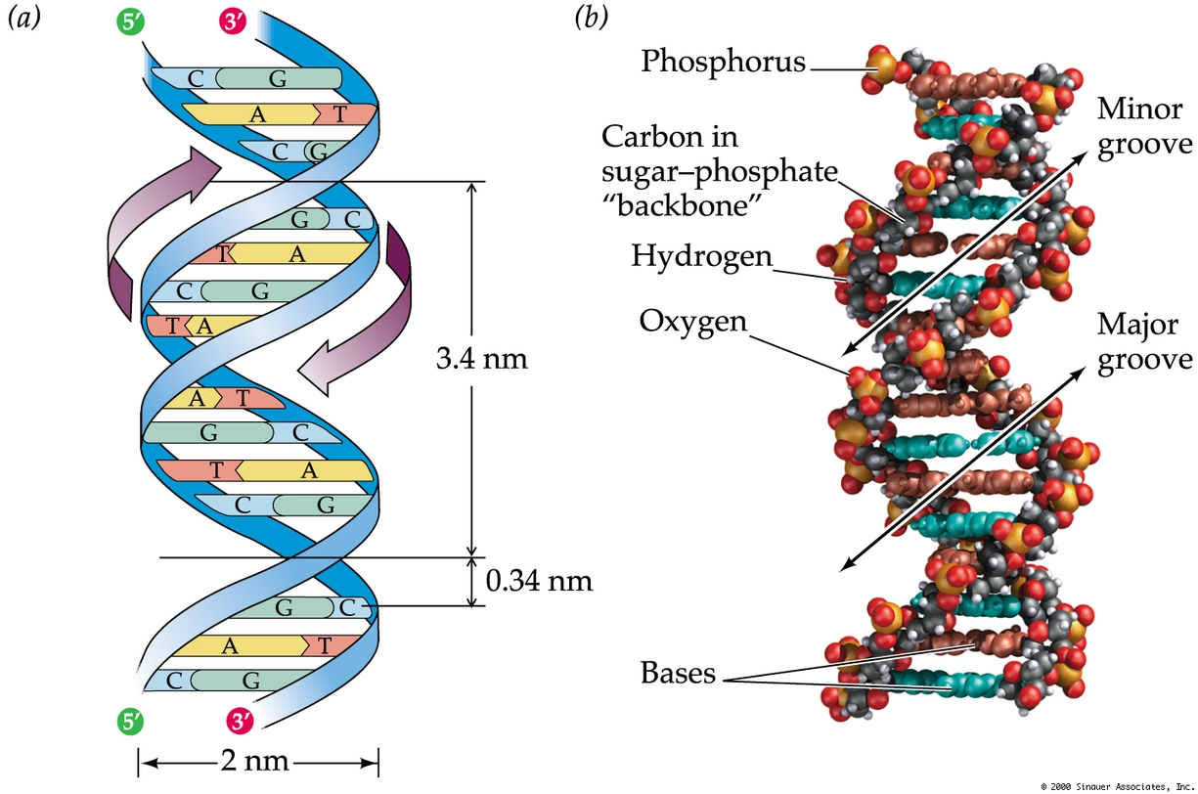
DNA Structure (RECAP)
DNA is a helical structure with distinctive regularities, 0.34 nm & 3.4 nm.

Slide 9
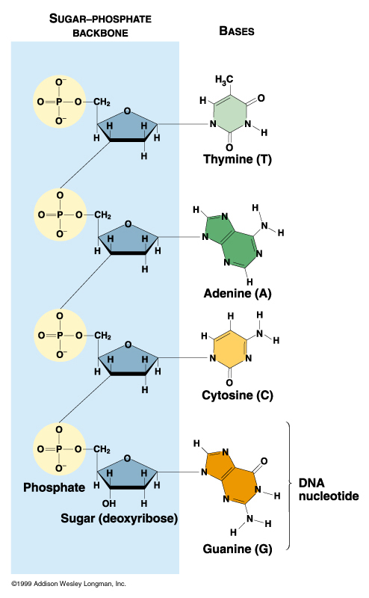
The Structure of DNA
DNA is composed of four nucleotides, each containing: adenine, cytosine, thymine, or guanine.
The amounts of A = T, G = C, and purines = pyrimidines [Chargaff’s Rule].
DNA is a double-stranded helix with antiparallel strands [Watson and Crick].
Nucleotides in each strand are linked by 5’-3’ phosphodiester bonds
Bases on opposite strands are linked by hydrogen bonding: A with T, and G with C.

Slide 10
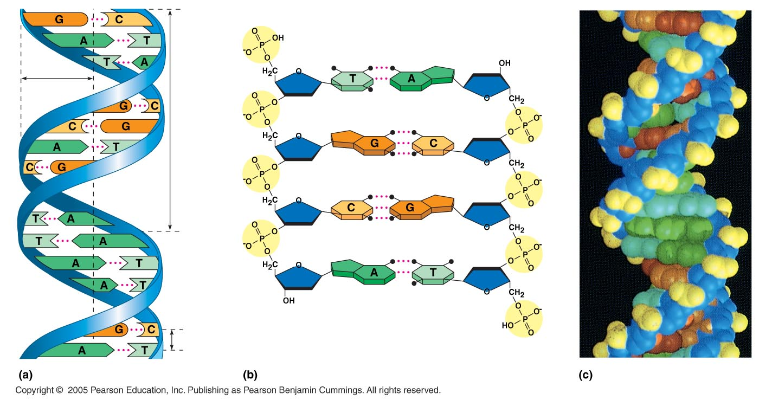
The Basic Principle: Base Pairing to a Template Strand
The relationship between structure and function is manifest in the double helix
Since the two strands of DNA are complementary each strand acts as a template for building a new strand in replication
In DNA replication, the parent molecule unwinds, and two new daughter strands are built based on base-pairing rules
5′ end
Hydrogen bond
3′ end
1 nm
3.4 nm
3′ end
0.34 nm
5′ end

Slide 11
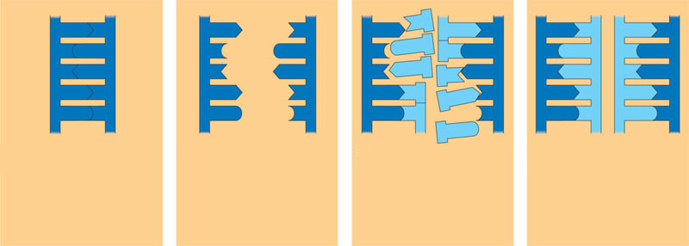
DNA replication
The parent molecule unwinds, and two new daughter strands are built based on base-pairing rules
A
T
A
T
A
T
A
T
A
T
A
T
C
G
C
G
C
G
C
G
C
G
C
G
T
A
T
A
T
A
T
A
T
A
T
A
A
T
A
T
A
T
A
T
A
T
A
T
G
C
G
C
G
C
C
G
C
G
C
G
(a) The parent molecule has two
complementary strands of DNA.
Each base is paired by hydrogen
bonding with its specific partner,
A with T and G with C.
(b) The first step in replication is
separation of the two DNA
strands.
(c) Each parental strand now
serves as a template that
determines the order of
nucleotides along a new,
complementary strand.
(d) The nucleotides are connected
to form the sugar-phosphate
backbones of the new strands.
Each “daughter” DNA
molecule consists of one parental
strand and one new strand.

Slide 12
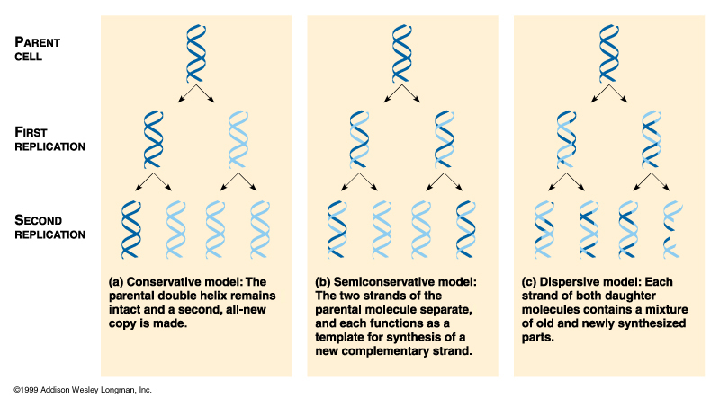
DNA Replication
DNA must replicate during each cell division
3 alternative models for DNA replication were hypothesized:
  Semiconservative replication
  Conservative replication
  Dispersive replication
Semi-conservative
Conservative
Dispersive

Slide 13
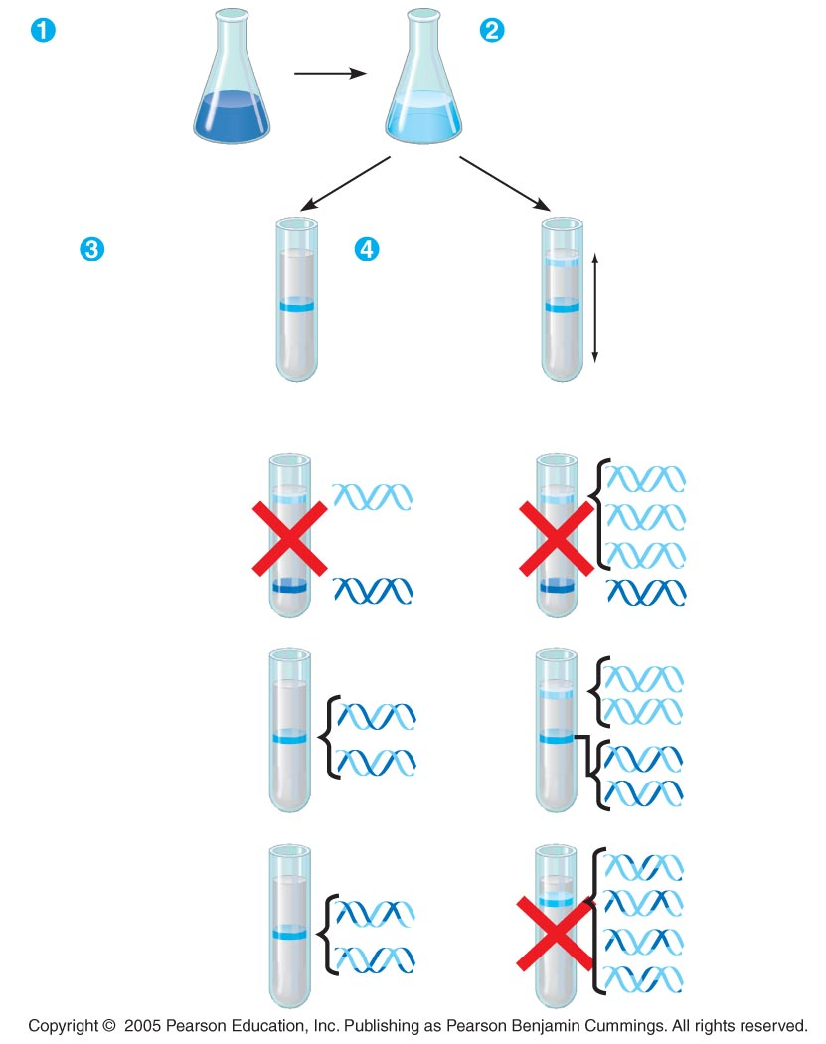
Meselson-Stahl Experiments
Labeled the nucleotides of old strands with a heavy isotope of nitrogen (¹⁵N), new nucleotides were indicated by a lighter isotope (¹⁴N).
The first replication in the 1⁴N medium produced a band of hybrid (¹⁵N-¹⁴N) DNA, eliminating the conservative model.
A second replication produced both light and hybrid DNA, eliminating the dispersive model and supporting the semi-conservative model.
Bacteria
cultured in
medium
containing
¹⁵N
Bacteria
transferred to
medium
containing
¹⁴N
DNA sample
centrifuged
after 20 min
(after first
replication)
DNA sample
centrifuged
after 40 min
(after second
replication)
Less
dense
More
dense
First replication
Second replication
Conservative
model
Semiconservative
model
Dispersive
model

Slide 14
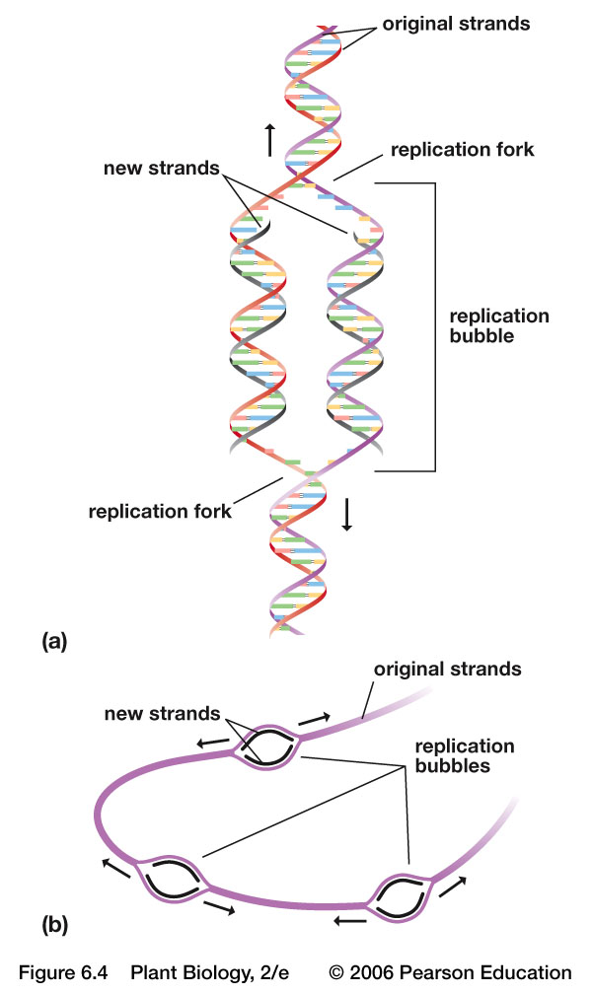
DNA Replication is “Semi-conservative”
Each 2-stranded daughter molecule is only half new
One original strand was used as a template to make the new strand

Slide 15
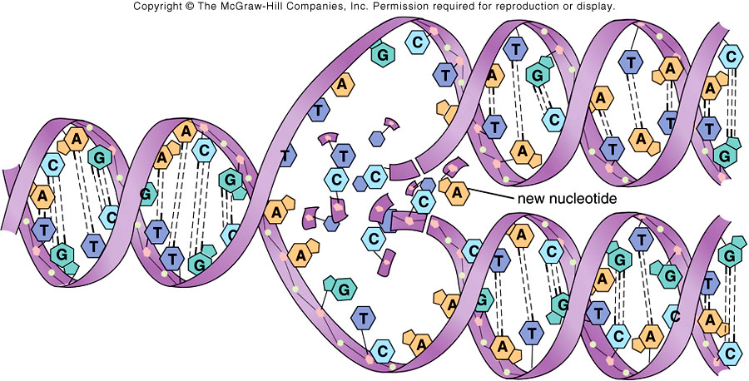
DNA Replication
The copying of DNA is remarkable in its speed and accuracy
Involves unwinding the double helix and synthesizing two new strands.
More than a dozen enzymes and other proteins participate in DNA replication
The replication of a DNA molecule begins at special sites called origins of replication, where the two strands are separated

Slide 16
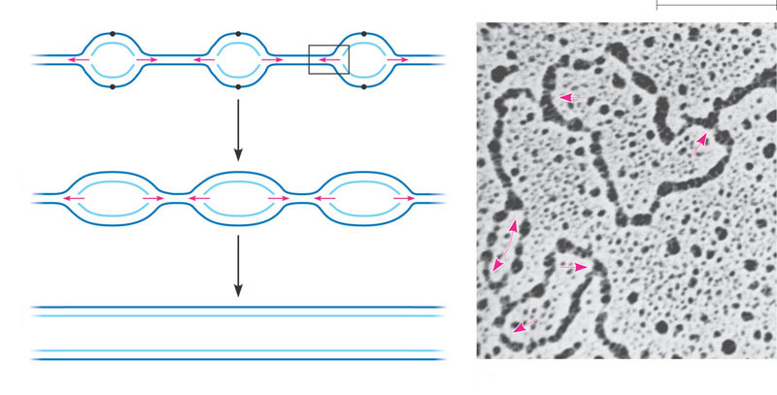
Origins of Replication
A eukaryotic chromosome may have hundreds or even thousands of replication origins
Origin of replication
Parental (template) strand
0.25 µm
Daughter (new) strand
1
Replication begins at specific sites
where the two parental strands
separate and form replication
bubbles.
Bubble
Replication fork
2
The bubbles expand laterally, as
DNA replication proceeds in both
directions.
3
Eventually, the replication
bubbles fuse, and synthesis of
the daughter strands is
complete.
Two daughter DNA molecules
(a)
In eukaryotes, DNA replication begins at many sites along the giant
DNA molecule of each chromosome.
(b)
In this micrograph, three replication
bubbles are visible along the DNA of
a cultured Chinese hamster cell (TEM).

Slide 17
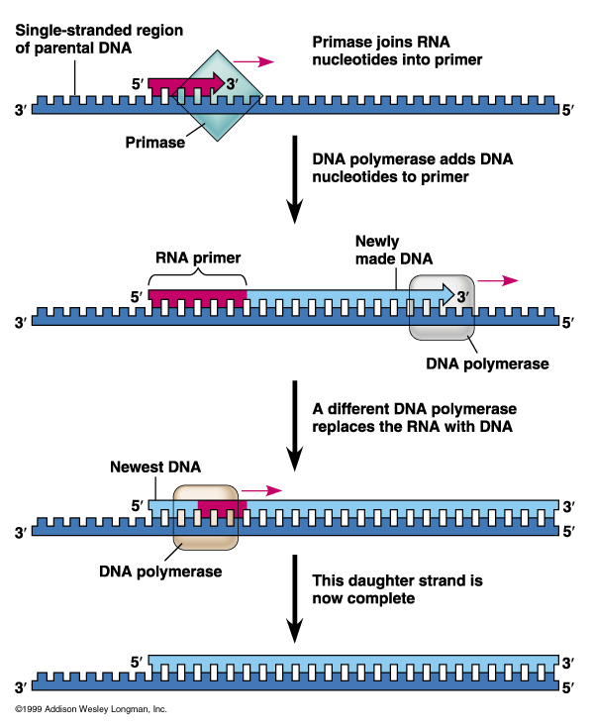
Mechanism of DNA Replication
DNA replication is catalyzed by DNA polymerase III which needs an RNA primer
DNA polymerase III cannot initiate the synthesis of a polynucleotide, they can only add nucleotides to the 3′ end
The initial nucleotide strand is an RNA primer
RNA primase synthesizes primer on DNA strand
DNA polymerase adds nucleotides to the 3’ end of the growing strand
DNA polymerase III adds nucleotides to primer
DNA polymerase I degrades the RNA primer and replaces it with DNA

Slide 18
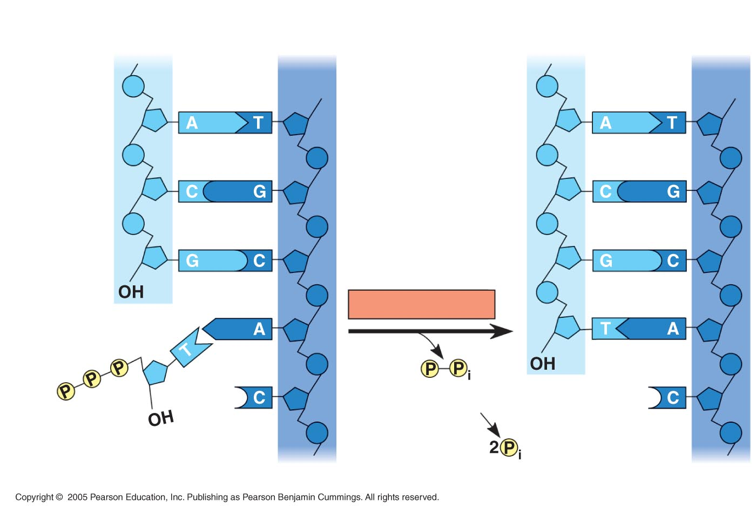
Mechanism of DNA Replication
Nucleotides are added by complementary base pairing with the template strand
DNA always reads from 5’ end to 3’ end for transcription replication
During replication, new nucleotides are added to the free 3’ hydroxyl on the growing strand
The nucleotides (deoxyribonucleoside triphosphates) are hydrolyzed as added, releasing energy for DNA synthesis.
The rate of elongation is about 500 nucleotides per second in bacteria and 50 per second in human cells
New strand
Template strand
5′ end
3′ end
5′ end
3′ end
Sugar
Phosphate
Base
3′ end
DNA polymerase
Pyrophosphate
3′ end
Nucleoside
triphosphate
5′ end
5′ end

Slide 19
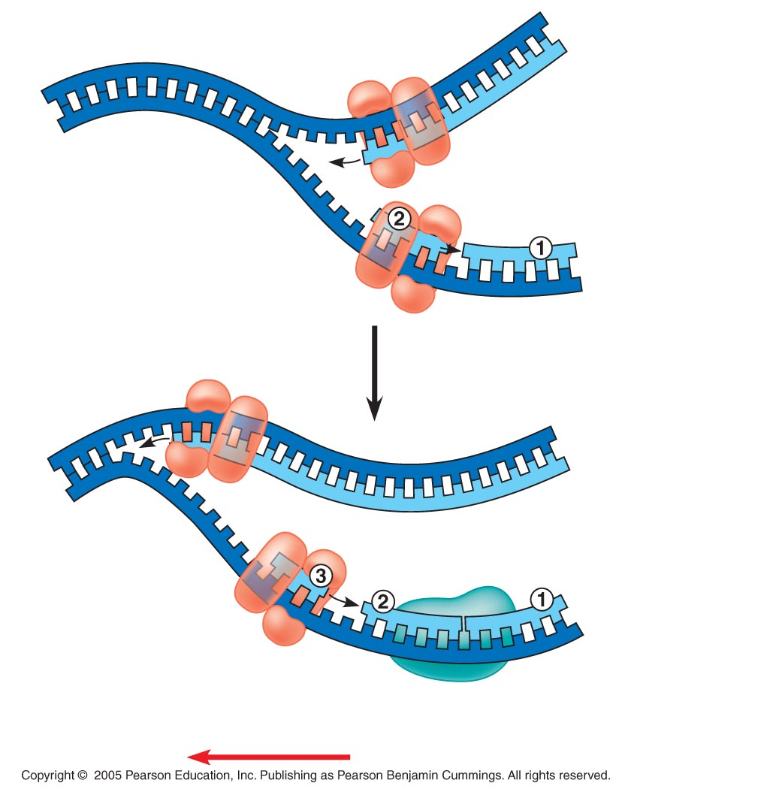
The Mechanism of DNA Replication
DNA synthesis on the leading strand is continuous
Only one primer is needed for synthesis of the leading strand
The lagging strand grows the same general direction as the leading strand (in the same direction as the Replication Fork). However, DNA is made in the 5’-to-3’ direction
Therefore, DNA synthesis on the lagging strand is discontinuous
For synthesis of the lagging strand, each fragment (Okazaki) must be primed separately, then DNA fragments are sythesized and subsequently ligated together
3′
Parental DNA
5′
Leading strand
5′
3′
Okazaki
fragments
Lagging strand
3′
5′
DNA pol III
Template
strand
Leading strand
Lagging strand
Template
strand
DNA ligase
Overall direction of replication

Slide 20
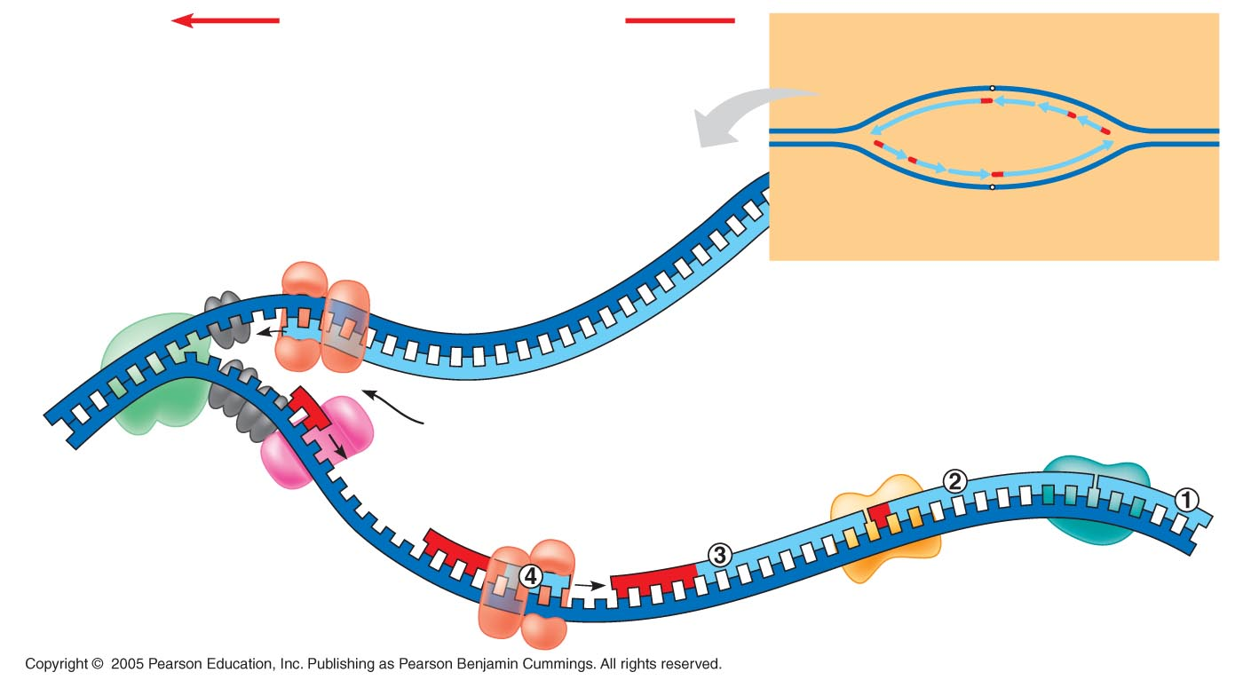
Mechanism of DNA Replication
Many proteins assist in DNA replication
  DNA helicases unwind the double helix, the template strands are stabilized by other proteins
  Single-stranded DNA binding proteins make the template available
  RNA primase catalyzes the synthesis of short RNA primers, to which nucleotides are added.
  DNA polymerase III extends the strand in the 5’-to-3’ direction
  DNA polymerase I degrades the RNA primer and replaces it with DNA
  DNA ligase joins the DNA fragments into a continuous daughter strand
Overall direction of replication
Leading
strand
Origin of replication
Lagging
strand
Leading
strand
Lagging
strand
Leading
strand
DNA pol III
OVERVIEW
5′
Replication fork
DNA ligase
3′
Primase
DNA pol I
Parental DNA
Primer
DNA pol III
3′
Lagging
strand
5′

Slide 21
Replication
Overall direction
of replication
3’
3’
5’
5’
3’
5’
3’
5’
Leading strand synthesis continues in a
5’ to 3’ direction.

Slide 22
Replication
Overall direction
of replication
3’
3’
5’
5’
Okazaki fragment
3’
3’
5’
5’
3’
5’
Leading strand synthesis continues in a
5’ to 3’ direction.
Discontinuous synthesis produces 5’ to 3’ DNA
segments called Okazaki fragments.

Slide 23
Replication
Overall direction
of replication
3’
3’
5’
5’
Okazaki fragment
3’
3’
5’
5’
3’
5’
Leading strand synthesis continues in a
5’ to 3’ direction.
Discontinuous synthesis produces 5’ to 3’ DNA
segments called Okazaki fragments.

Slide 24
Replication
Overall direction
of replication
3’
3’
5’
5’
Okazaki fragment
3’
5’
3’
5’
3’
5’
Leading strand synthesis continues in a
5’ to 3’ direction.
Discontinuous synthesis produces 5’ to 3’ DNA
segments called Okazaki fragments.

Slide 25
Replication
3’
3’
5’
5’
3’
5’
3’
3’
3’
5’
5’
5’
Leading strand synthesis continues in a
5’ to 3’ direction.
Discontinuous synthesis produces 5’ to 3’ DNA
segments called Okazaki fragments.

Slide 26
Replication
3’
3’
5’
5’
3’
5’
3’
3’
3’
5’
5’
5’
Leading strand synthesis continues in a
5’ to 3’ direction.
Discontinuous synthesis produces 5’ to 3’ DNA
segments called Okazaki fragments.

Slide 27
Replication
3’
3’
5’
5’
3’
5’
3’
3’
3’
5’
5’
5’
Exonuclease activity of DNA polymerase I removes RNA primers.

Slide 28
Replication
3’
3’
5’
3’
5’
3’
3’
5’
5’
Polymerase activity of DNA polymerase I fills the gaps.
Ligase forms bonds between sugar-phosphate backbone.

Slide 29
Replication Fork Overview
Overall direction of replication
Leading
strand
Lagging
strand
Origin of replication
Leading
strand
Lagging
strand
Leading
strand
OVERVIEW
DNA pol III
Replication fork
DNA ligase
5′
DNA pol I
3′
Primase
Parental DNA
Primer
DNA pol III
3′
Lagging
strand
5′

Slide 30
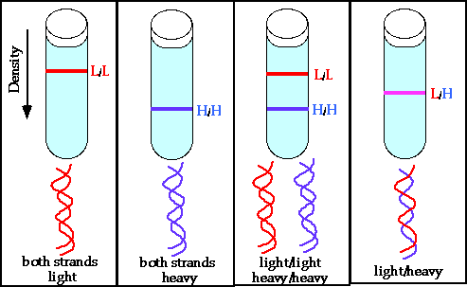
¹⁴N/¹⁴N
¹⁵N/¹⁵N
¹⁴N/¹⁴N
¹⁵N/¹⁵N
¹⁴N/¹⁵N

Slide 31
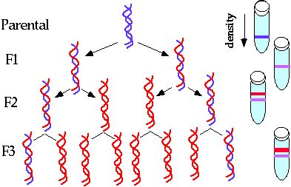

Slide 32
Your home work :
Create Concept maps of the topic so far covered

